Slide 1

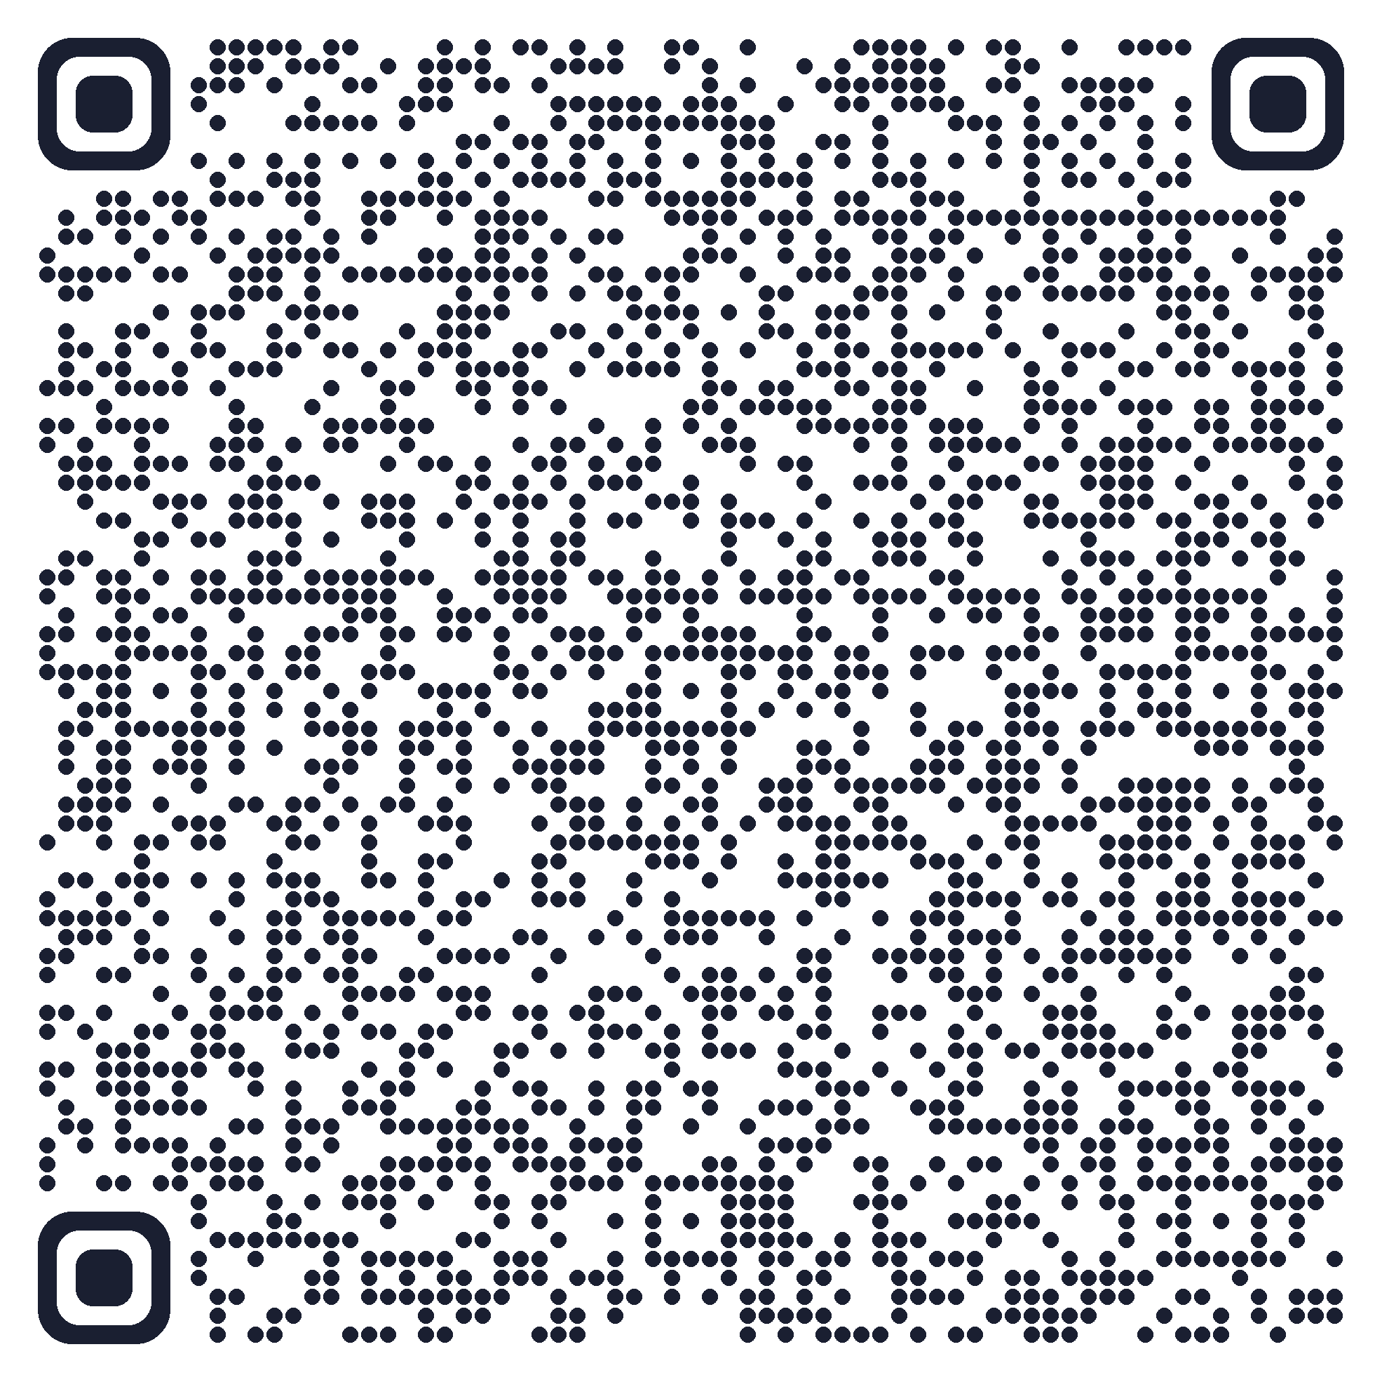

Liver Transplantation
When to Refer and What's New
Mohammad Almeqdadi, MD
Transplant Hepatologist, Tufts Medical Center
Assistant Professor of Medicine and Surgery
Tufts University School of Medicine
X: @mfalmeqdadi
Slides (PDF)
Illustrations generated with Google Gemini
Notes:
Maine Medical Center grand rounds. About 45 minutes, then questions. After a short history, five parts that follow the patient: when to refer, who can be a candidate now, what happens after the referral, where the livers come from, and what to do when a transplant patient lands on your service. Start by thanking the people who invited me, by name, and the Maine Med hepatology group.

Slide 2
Disclosures
No relevant financial relationships to disclose.
2/47

Slide 3

Objectives
Recognize who to refer, and who needs a call the same day
See who can be a transplant candidate now
Walk through what happens after the referral
Understand where donor livers come from now
Care for a transplant recipient on your service
3/47
Notes:
Five parts, in the order a patient goes through them. The first two are for everyone who sees patients with liver disease, the donor part has the newer data, and the last part is for anyone who admits a transplant patient. Say that last sentence out loud, so the cardiologists and surgeons know to stay.

Slide 4
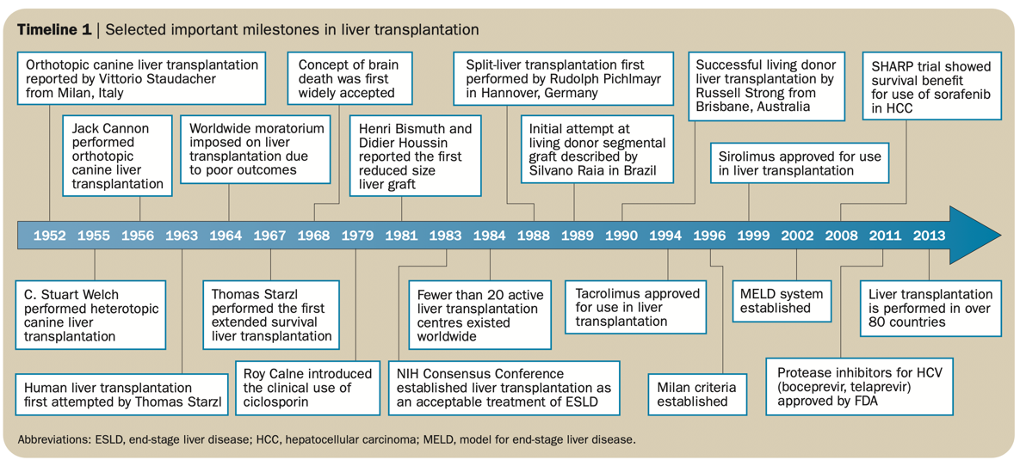
How did liver transplant start?
Timeline 1 from Zarrinpar A, Busuttil RW. Nat Rev Gastroenterol Hepatol 2013;10(7):434-40 [PMID: 23752825]
4/47
Notes:
The first human liver transplant was attempted by Thomas Starzl in Denver in March 1963, in a child with biliary atresia who didn't survive the operation. The next several patients died within weeks, and programs stopped. In 1967 Starzl had the first patient who lived more than a year. What made it a real treatment was immunosuppression: Calne's cyclosporine at the end of the 1970s, and the 1983 NIH consensus conference that called liver transplant a treatment for end-stage liver disease rather than an experiment.

Slide 5
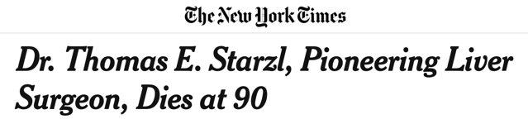
Who was Thomas Starzl?
1963, Denver: first human liver transplant attempt
1967: first patient to live more than a year after one
1980: cyclosporine with steroids; survival finally good enough to offer it widely
1989, Pittsburgh: tacrolimus
Died March 4, 2017, at 90
The New York Times, March 5, 2017. Starzl TE et al. Homotransplantation of the liver in humans. Surg Gynecol Obstet 1963;117:659-76 [PMID: 14100514]
5/47
Notes:
He moved to Pittsburgh in 1981, and tacrolimus (FK506) came out of his program there in 1989. He died at home in Pittsburgh.

Slide 6
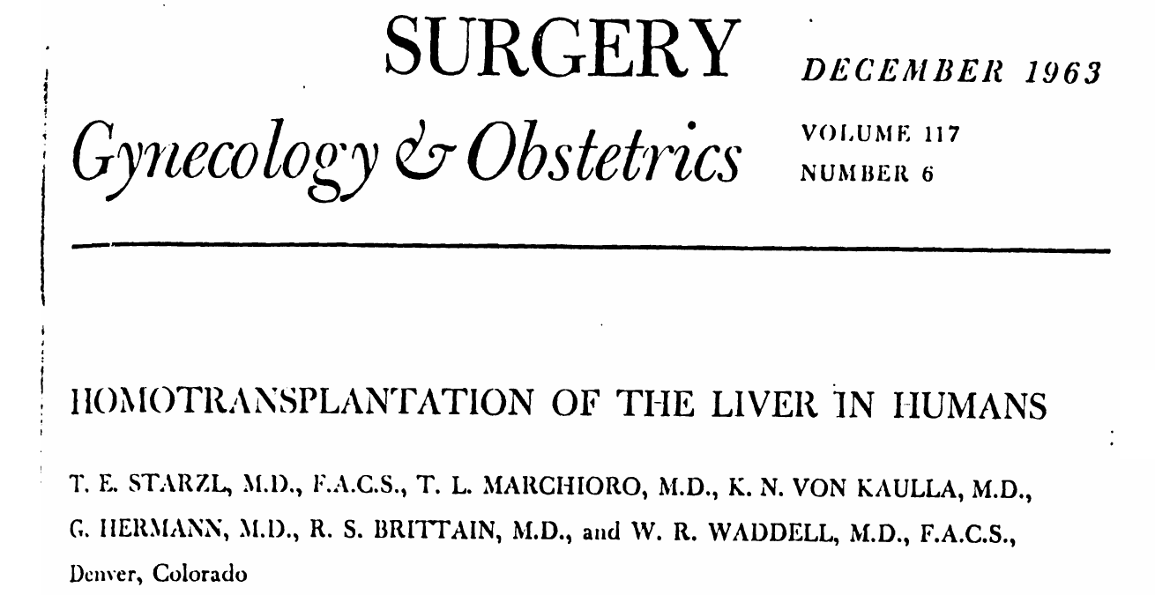
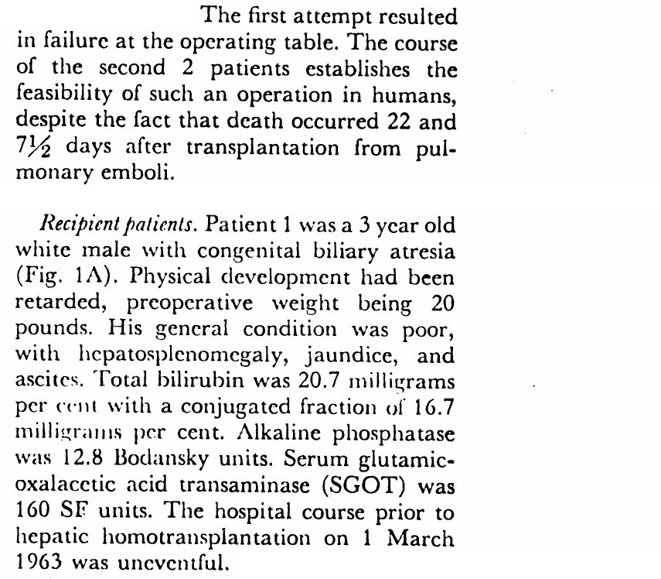
How did the first liver transplants go?
Patient 1, 1 March 1963: a 3-year-old with biliary atresia, died of bleeding on the operating table
Patients 2 and 3 died 22 and 7½ days later, of pulmonary emboli
Starzl TE et al. Surg Gynecol Obstet 1963;117:659-76 [PMID: 14100514]. Scan: University of Pittsburgh D-Scholarship
6/47
Notes:
The original paper, from Denver. The first child died on the table of hemorrhage from a profound clotting defect, which the paper describes in detail. The next two lived long enough to show the operation could be done, and both died of pulmonary emboli. After more deaths, programs stopped in 1964 until Starzl tried again in 1967. Optional line: "The case report gives his alkaline phosphatase in Bodansky units. I had to look that up."

Slide 7
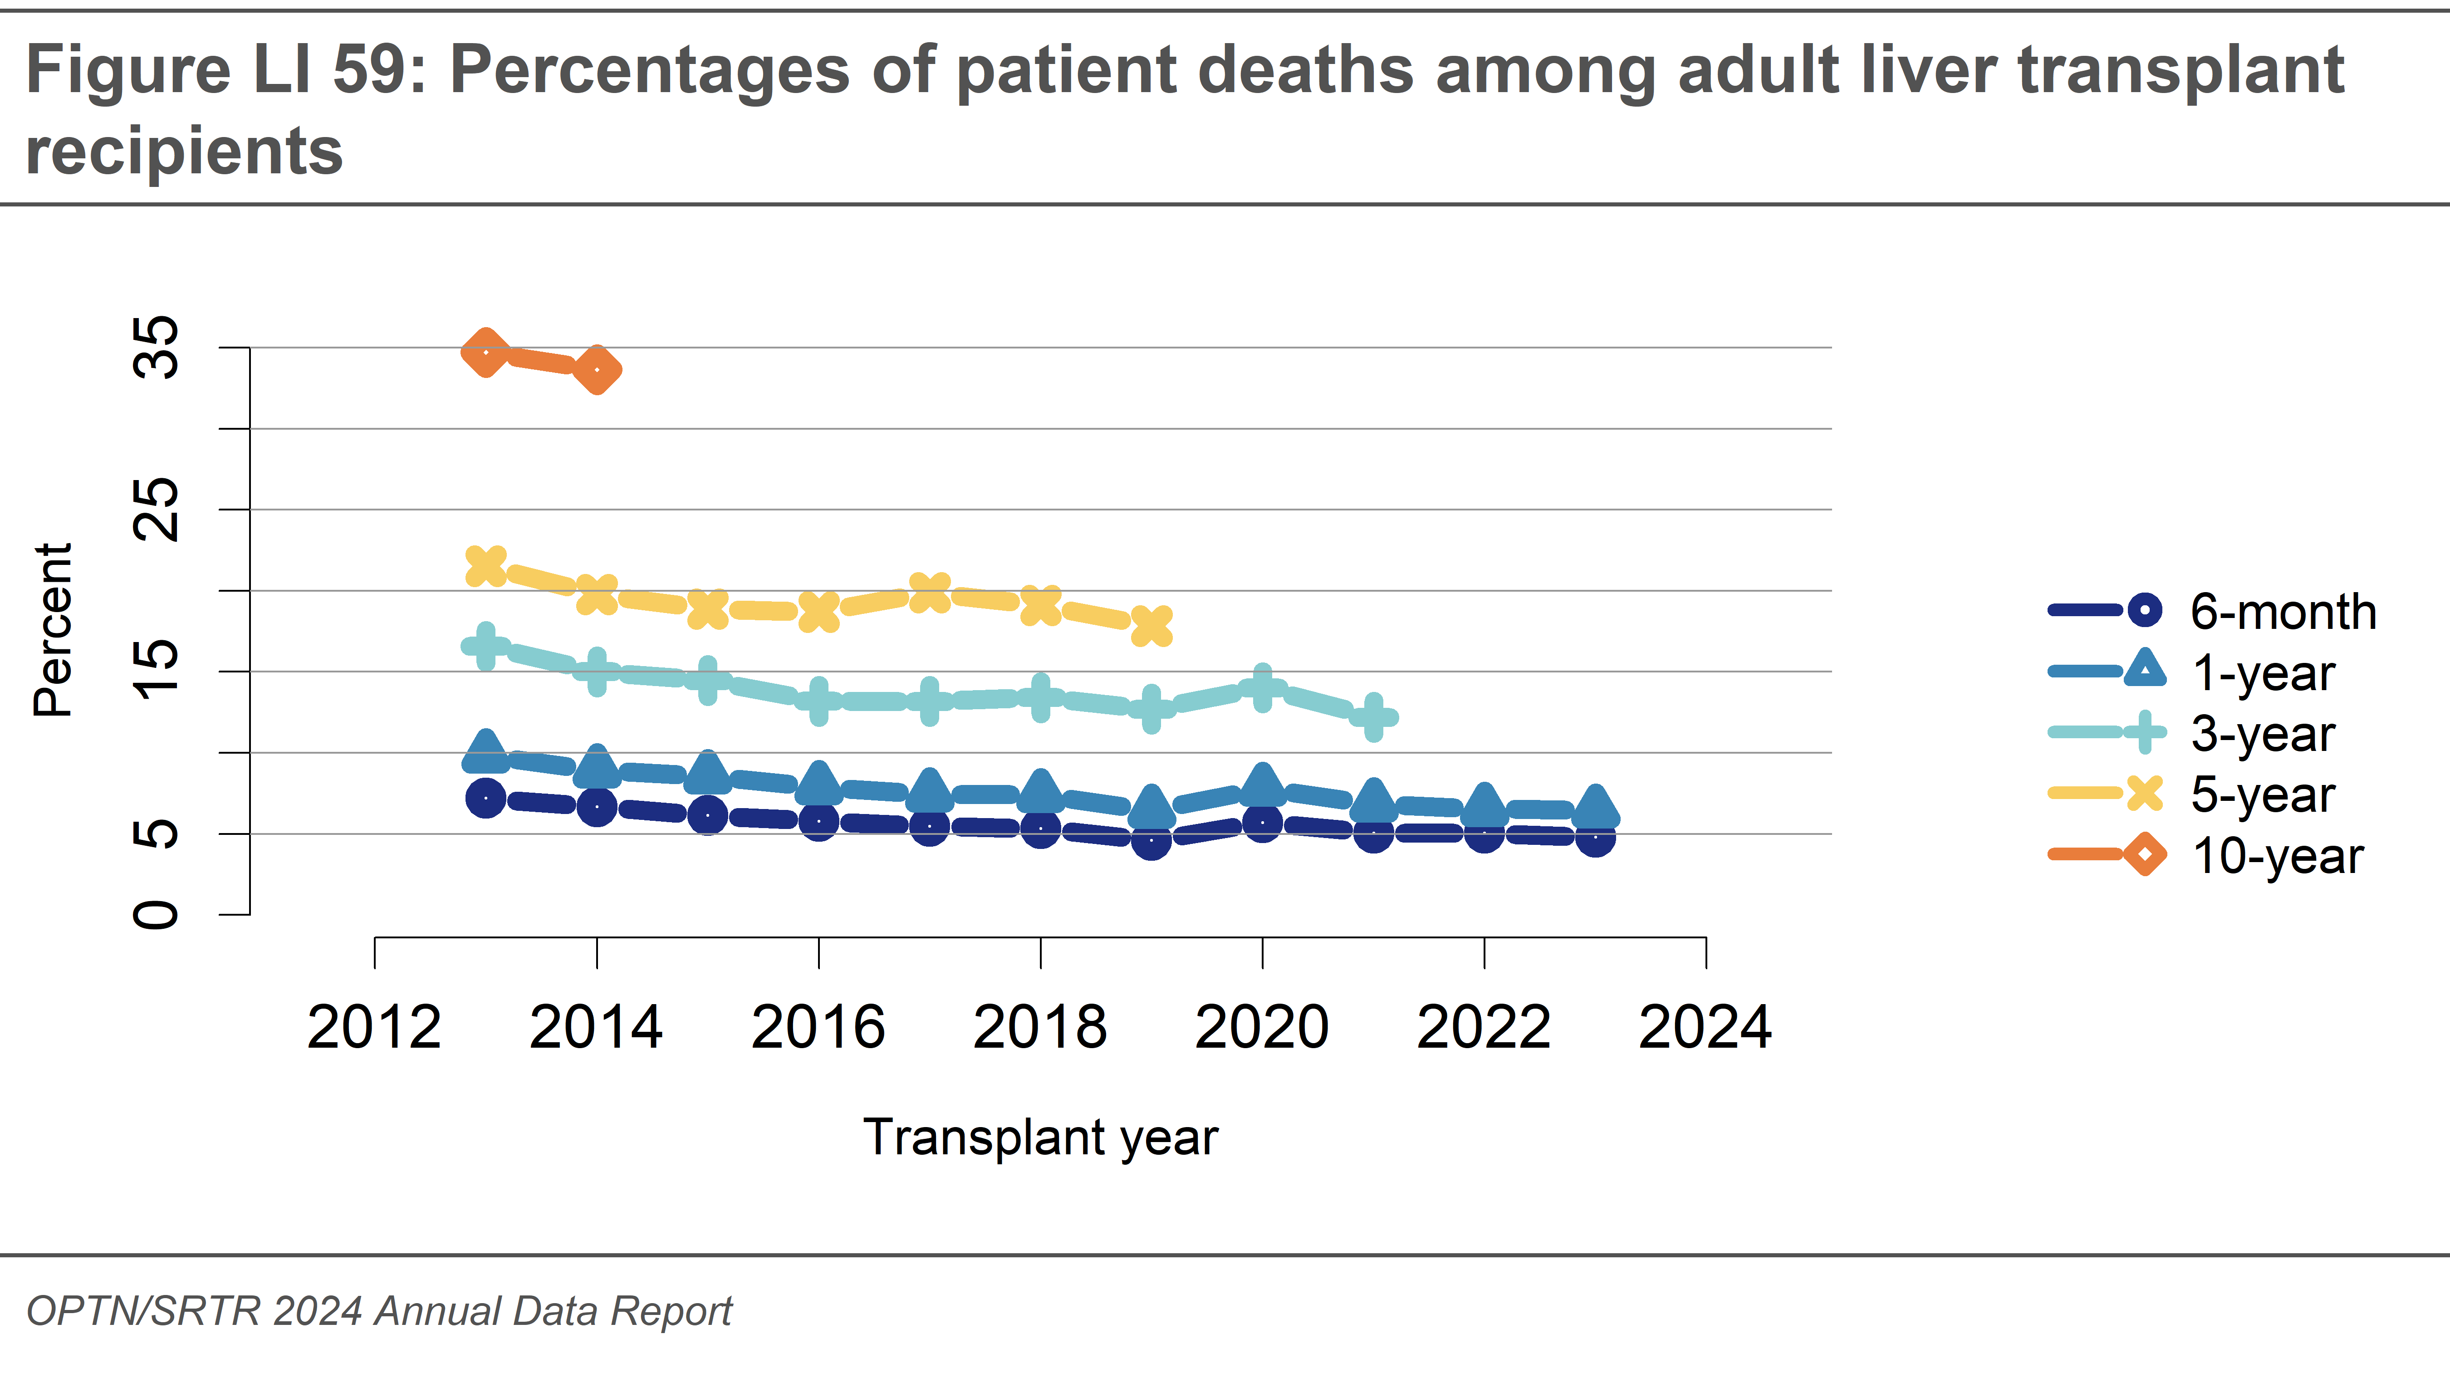
How do patients do after a liver transplant?
OPTN/SRTR 2024 Annual Data Report, Figure LI 59. Am J Transplant 2026;26(8S1):S214-S320 [PMID: 42276697]
7/47
Notes:
These are mortality lines, not survival curves: each line is the share of adult recipients who had died by that point, by the year they were transplanted. Mortality has come down at most time points, though not every year. One-year patient survival for adults who got a deceased donor liver in 2023 was 93.5%. Of adults transplanted in 2014, 33.6% had died by 10 years [PMID: 42276697].

Slide 8
How much has liver transplant grown?
11,458 in 2024 (10,886 adults), 70% more than in 2014
OPTN/SRTR Annual Data Reports, Liver, 2020-2024 [PMIDs: 35266621, 37132348, 38431359, 39947804, 42276697]
8/47
Notes:
Every year since 2020 has been a record. The 2024 report gives 70.3% more than in 2014. Part of the growth is more DCD livers and machine perfusion, which we'll come back to.

Slide 9

When to refer
9/47
Notes:
The part of the talk that matters most for most of the room.

Slide 10
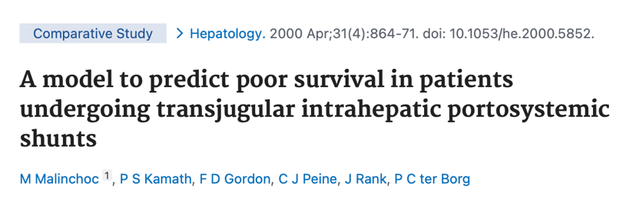
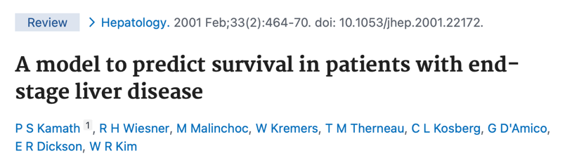
Where did MELD come from?
2000: built at Mayo to predict death after an elective TIPS
2001: worked just as well across end-stage liver disease
2002: became the basis for US liver allocation
Malinchoc M, Kamath PS, Gordon FD, et al. Hepatology 2000;31(4):864-71 [PMID: 10733541]. Kamath PS et al. Hepatology 2001;33(2):464-70 [PMID: 11172350]
10/47
Notes:
MELD started as a TIPS score. Fredric Gordon, one of the authors of the original paper, is our colleague at Tufts. Optional line: "MELD was built to predict who would die after a TIPS. A year later it was deciding who gets a liver."

Slide 11
Why did MELD 15 become the rule?
2005
MELD
MELD 6-11
12-14
15-17
18 and up
Transplant raised the 1-year risk of death (HR 3.6)
Still raised it (HR 2.4)
No significant difference: the crossover
38% lower risk at 18-20, 96% lower at 40
2023
MELD-Na
Below 12
12 and up
No significant benefit
1-year benefit (HR 0.74), more than 9 life-years gained at 12
Neither number has been set for MELD 3.0. Referral is a separate question: refer after any decompensating event, whatever the MELD. Without one, 15 is still reasonable.
Merion RM et al. Am J Transplant 2005;5(2):307-13 [PMID: 15643990]. Malamon JS et al. Int J Surg 2023;109(9):2714-20 [PMID: 37226874]. Dove L et al. Hepatology 2026, statement 1 [PMID: 41405234]
11/47
Notes:
This is where 15 came from. Merion used MELD as it changed on the list, comparing transplant with staying on the list. Below 15, transplant raised the one-year risk of death. At 15-17 there was no significant difference either way; that was the crossover. From 18 up the benefit was clear and grew with MELD. A 2009 decision analysis (Perkins) came to the same threshold. The newer data move it down. Malamon 2023, in the MELD-Na era, found a one-year benefit from deceased donor transplant starting at MELD-Na 12 (HR 0.74), whether or not the patient had HCC. That is what the 2025 guideline cites for 'may start at 12'. With a living donor, Jackson 2022 found benefit from MELD-Na 11; that's later in the talk. The guideline says there isn't contemporary data for a MELD 3.0 threshold. These are waitlist studies: they compare transplant with staying on the list, not when to refer. Refer after any decompensation whatever the score; without one, the guideline's writing group still sees 15 as reasonable. Evaluation and listing take time, so referral comes before the point of benefit, not at it. Backup if asked: a 2025 Liver Transplantation analysis reported benefit at MELD 3.0 12-14 (PMID 41378690); I haven't verified it, and the guideline doesn't use it.

Slide 12
What's new in MELD 3.0?
 | MELD-Na | MELD 3.0
Bilirubin | ✓ | ✓
INR | ✓ | ✓
Creatinine | ✓ (cap 4.0) | ✓ (cap 3.0)
Sodium | ✓ | ✓
Albumin |  | ✓
Female sex |  | ✓ (+1.33)
Interaction terms | MELD × Na | Bili × Na, albumin × Cr
Used for allocation since July 2023
90-day mortality: C-statistic 0.869 vs 0.862
In simulation, at least 20 fewer waitlist deaths a year
Kim WR, Mannalithara A, Heimbach JK, et al. Gastroenterology 2021;161(6):1887-1895.e4 [PMID: 34481845]
12/47
Notes:
Optional line before the formula: "I know what you're thinking... no, nobody has to calculate it." MELD 3.0 = 1.33 (if female) + 4.56 ln(bilirubin) + 0.82 (137 − Na) − 0.24 (137 − Na) ln(bilirubin) + 9.09 ln(INR) + 11.14 ln(creatinine) + 1.85 (3.5 − albumin) − 1.83 (3.5 − albumin) ln(creatinine) + 6. Women had higher waitlist mortality at the same lab values; the sex term covers part of that, and the access gap tied to body size is still there. For real numbers use the OPTN calculator, which applies the lab bounds (sodium 125-137, albumin 1.5-3.5, creatinine 1-3), the dialysis rule, rounding, and the 6-40 range.

Slide 13
Did MELD 3.0 help women?
Conference analysis, 12 months before vs 12 months after July 2023. Dropout: died or too sick for transplant
Kwong AJ, The Liver Meeting 2024, abstract 5002 (conference data). Tanaka T et al. Hepatology 2026;84(1):106-16 [PMID: 41100798]. Di Napoli M et al. Front Transplant 2026 [PMID: 42266471]. SRTR 2024 ADR [PMID: 42276697]
13/47
Notes:
Two numbers: the share of transplants that went to women, and how many waitlisted women dropped out within 90 days, before and after July 2023.

Slide 14
Did MELD 3.0 help women?
Conference analysis, 12 months before vs 12 months after July 2023. Dropout: died or too sick for transplant
The gain was largest right after the change and narrowed over time. Waitlisted women still die more often: 15.0 vs 12.4 per 100 patient-years in 2024.
Kwong AJ, The Liver Meeting 2024, abstract 5002 (conference data). Tanaka T et al. Hepatology 2026;84(1):106-16 [PMID: 41100798]. Di Napoli M et al. Front Transplant 2026 [PMID: 42266471]. SRTR 2024 ADR [PMID: 42276697]
13/47
Notes:
Transplants to women went from 37.0% to 41.7%, and 90-day dropout in women fell from 14.4% to 9.1% (conference data). Tanaka compared the change in women with the change in men: the relative gain in transplant access for women was OR 1.36 at implementation and 1.18 at 3 months, and it faded later. The gap hasn't closed.

Slide 15
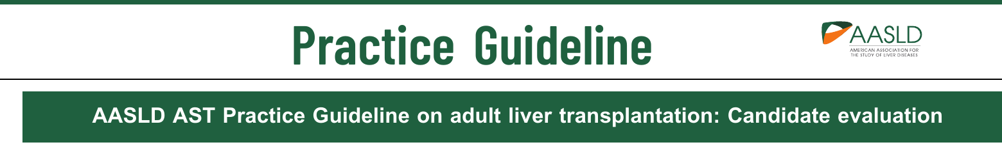
When should a patient with cirrhosis be referred?
Ascites, with or without SBP
Hepatocellular carcinoma
Variceal or portal hypertensive gastropathy bleeding
Refer for liver transplant evaluation
Hepatopulmonary syndrome or portopulmonary hypertension
Hepatic encephalopathy
MELD 3.0 ≥12
The 2025 guideline: refer after any decompensating event. Without one, the MELD threshold is unclear: benefit may start at 12 in waitlisted patients, and most of the writing group still sees 15 as reasonable. “MELD score alone should not be a barrier to referral.”
Figure 1 redrawn from Dove L et al. AASLD/AST candidate evaluation guideline. Hepatology 2026;83(6):1609-45 [PMID: 41405234], statement 1
14/47
Notes:
This is Figure 1 of the new guideline, redrawn. The 2025 AASLD/AST guidelines number each recommendation as a statement; the numbers are in the footers if anyone wants to look one up. In the figure, the MELD 3.0 ≥12 box is theirs. Any one of these events is a reason to call. The 2013 guideline said MELD 15. The MELD 12 number comes from studies of patients already on the waitlist, which weren't designed to answer when to refer. So without complications there is no firm cutoff, and 15 is still reasonable. With uncontrolled portal hypertensive complications, refer at any MELD.

Slide 16

Who needs a call the same day?
Acute liver failure
INR ≥1.5 and any encephalopathy, no cirrhosis
Call transplant hepatology
Severe acute liver injury
Jaundice and a rising INR, still awake
ACLF
Cirrhosis with new organ failure
ALF: call “in the first few hours after presentation, and prior to meeting ALF diagnostic criteria.” Insurance, substance use or infection shouldn't hold up the call.
ACLF: consider referral early, while the patient can still travel.
Dove L et al. AASLD/AST candidate evaluation guideline. Hepatology 2026;83(6):1609-45 [PMID: 41405234], statements 2-4. ACG ALF guideline 2023 [PMID: 37377263]
15/47
Notes:
This is the one that matters most for a hospital without a transplant program. About a third of ALF patients get a transplant, a third recover, and the transplant center can help with both. Don't wait for King's College criteria or for encephalopathy to get worse. For ALF the guideline says barriers like insurance, substance use or infection shouldn't stop the referral, because experienced centers can often get around them, and complications can make the transfer unsafe later. For ACLF it says to consider referral; calling the same day is our practice, not the guideline's wording. The ICU side of ALF and ACLF is in my ALF lecture.

Slide 17

Who can get a liver now
16/47
Notes:
Selection has changed for three groups: severe alcohol-associated hepatitis, ACLF, and some cancers.

Slide 18
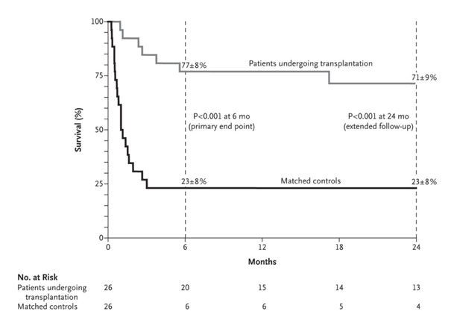
Can a patient who drank last month get a liver?
France and Belgium, not the US
First episode of severe AH, not responding to steroids, strict medical and psychosocial selection
26 patients, fewer than 2% of severe AH admissions
6-month survival 77% vs 23% in matched controls
Mathurin P, Moreno C, Samuel D, et al. N Engl J Med 2011;365(19):1790-800 [PMID: 22070476]
17/47
Notes:
This was the paper that broke the 6-month rule. Very selected patients, and the benefit was large: 77 ± 8% vs 23 ± 8% at 6 months, P<0.001.

Slide 19
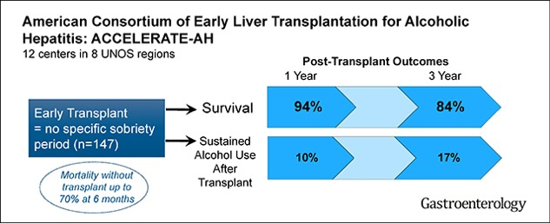
Did it hold up in the US?
ACCELERATE-AH, 147 patients: sustained alcohol use carried a higher risk of death (HR 4.59)
2025 analysis, 347 patients alive at discharge: 5-year survival 83.1%
Lee BP et al. Gastroenterology 2018;155(2):422-430.e1 [PMID: 29655837]. Dukewich M et al. Am J Gastroenterol 2025;120(4):827-36 [PMID: 38994850]
18/47
Notes:
1-year survival 94% and 3-year 84%. Sustained use was 10% at 1 year and 17% at 3 years. In the 2025 analysis, continued harmful drinking carried an aHR of 3.59 (2.17-5.95) for death, and patients who got back to abstinence had predicted survival close to those who never drank harmfully. Finding and treating a return to drinking after transplant matters as much as the operation.

Slide 20
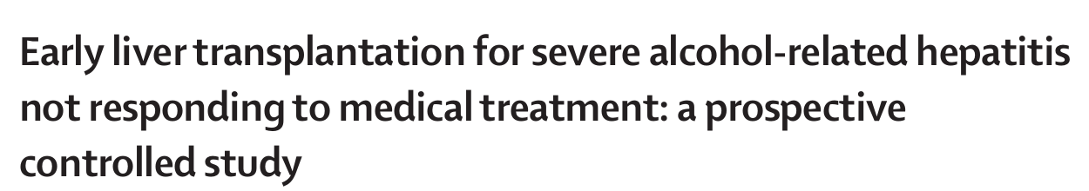
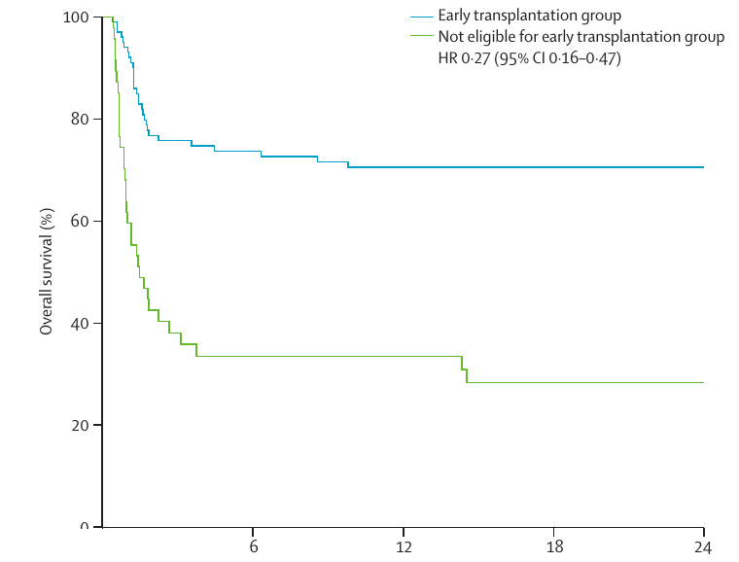
What about relapse?
Early-LT strategy vs patients not eligible: 2-year survival 70.6% vs 28.3%
Non-inferiority for relapse not shown
Louvet A, Labreuche J, Moreno C, et al. Lancet Gastroenterol Hepatol 2022;7(5):416-25 [PMID: 35202597]
19/47
Notes:
The two panels compare different groups. The survival curve is everyone offered early transplant, transplanted or not, against patients who weren't eligible. The relapse bars are transplanted patients only, early vs standard transplant. High alcohol intake was more common after early transplant, and non-inferiority for any relapse wasn't shown. Days abstinent were 81.9% vs 88.5% in the early-LT strategy and ineligible groups (p=0.16).

Slide 21
What do the guidelines say now?
Guideline | Early transplant for alcohol-associated hepatitis
EASL 2024 | Selected non-responders with favorable sobriety predictors (strong)
ACG 2024 | Carefully selected non-responders at low risk of relapse
AASLD/AST 2025 | Refer ALD early; abstinence duration alone doesn't exclude
EASL CPG on liver transplantation. J Hepatol 2024;81(6):1040-86, p.1044 [PMID: 39487043]. Jophlin LL et al. Am J Gastroenterol 2024;119(1):30-54 [PMID: 38174913]. Dove L et al. Hepatology 2026;83(6):1609-45 [PMID: 41405234], statements 37-38
20/47
Notes:
EASL and ACG speak directly to selected patients with severe alcohol-associated hepatitis. The AASLD/AST guideline has no numbered statement on early transplant for alcohol-associated hepatitis itself; it says to refer early and not to use the length of abstinence alone to exclude. It also says patients on methadone or buprenorphine shouldn't be denied or made to taper.

Slide 22
What do US adults get a liver for?
OPTN/SRTR 2024 Annual Data Report, Table LI 7. Kwong AJ et al. OPTN/SRTR 2024 Annual Data Report: Liver. Am J Transplant 2026;26(8S1):S214-S320 [PMID: 42276697]
21/47
Notes:
Share of US adult recipients in 2024 with alcohol-associated liver disease.

Slide 23
What do US adults get a liver for?
Alcohol-associated liver disease: 41.1% of US adult recipients, the top diagnosis
Parts are rounded, so they add to 41.2%
OPTN/SRTR 2024 Annual Data Report, Table LI 7. Kwong AJ et al. OPTN/SRTR 2024 Annual Data Report: Liver. Am J Transplant 2026;26(8S1):S214-S320 [PMID: 42276697]
21/47
Notes:
41% of adult recipients, a third with alcohol-associated cirrhosis and 7% with alcohol-associated hepatitis.

Slide 24
Can patients with ACLF get a liver?
CHANCE: 612 transplanted, 144 declined, 63 centers
Without ACLF: 9% case-fatality at a year after transplant
AASLD 2024: selected patients with ACLF may warrant expedited transplant; palliative care can run alongside the evaluation
Transplanted: case-fatality, no retransplant. Declined: 1-year mortality
Gustot T, Bernal W, Fernández J, et al. CHANCE. J Hepatol 2026 [PMID: 42822699]. Karvellas CJ et al. Hepatology 2024;79(6):1463-1502, statements 47, 51 [PMID: 37939273]
22/47
Notes:
These are case-fatality numbers, not survival. This was a prospective observational study, not randomized: the transplanted patients were selected. Even so, ACLF-3 did reasonably well after transplant, and most of the declined patients died. The ICU side of this is in my ALF and ACLF lecture.

Slide 25
What no longer rules a patient out?
On its own | What the 2025 AASLD/AST guideline says
Length of abstinence | Duration alone doesn't exclude
Methadone or buprenorphine | No denial, no taper needed
BMI >40 or <18.5 | Screen nutrition and muscle; BMI alone doesn't exclude
ACLF or MELD >40 | Doesn't exclude by itself
Older age, with a living donor | Not an exclusion
None of these is a cutoff on its own.
Dove L et al. AASLD/AST candidate evaluation guideline. Hepatology 2026;83(6):1609-45 [PMID: 41405234], statements 2, 38, 41, 43, 48-49, 51
23/47
Notes:
None of these should stop a first referral on its own. The 2025 guideline says each is weighed with everything else, not used as a cutoff.

Slide 26
Who gets exception points?
Exception | What's needed
Hepatocellular carcinoma | 1 lesion 2-5 cm, or 2-3 lesions each 1-3 cm AFP ≤1000 (if >1000, must fall below 500)
Hepatopulmonary syndrome or portopulmonary hypertension | Confirmed by testing; a standard exception
Colorectal metastases or intrahepatic cholangiocarcinoma | Case by case, through the review board
OPTN Policies 9.5.E, 9.5.G, 9.5.I (effective 10/1/2026); OPTN adult MELD exception transplant oncology review guidance
24/47
Notes:
MMaT is the median MELD at transplant for recent transplants near the donor hospital, so an exception score moves with the region. For HCC, the exception starts at the calculated MELD and goes to MMaT minus 3 after the first extension. Scores: HCC, HPS and PoPH get MMaT minus 3; colorectal metastases MMaT minus 20 with a floor of 15; iCCA MMaT minus 3. HPS needs room-air PaO2 under 60 with documented shunting, portal hypertension and no significant primary lung disease. PoPH needs mPAP 35 or more and PVR 3 WU or more before treatment, and after treatment mPAP under 35 with PVR under 5, or mPAP 35 to under 45 with PVR under 3. HCC, HPS and PoPH are standard exceptions in policy; the two oncology rows go through the review board under its guidance, in place since February 2025.

Slide 27
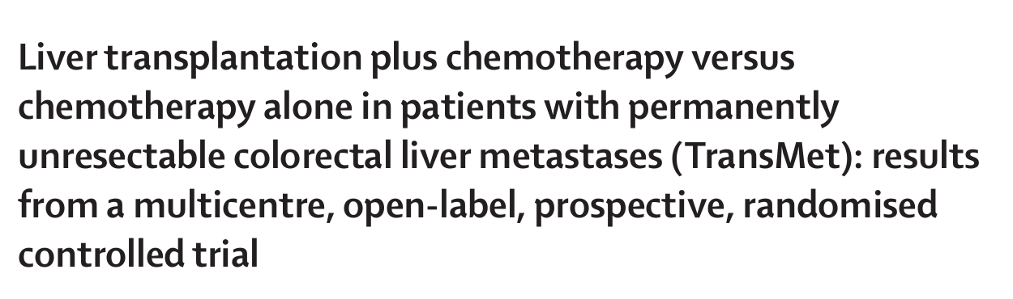
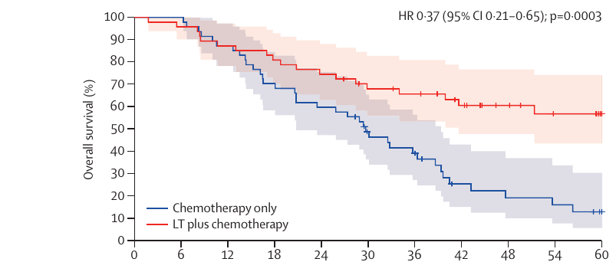
Can a liver transplant help colorectal metastases?
20 centers in France, Belgium and Italy, not the US
94 randomized: age 18-65, BRAF wild-type, primary resected, permanently unresectable liver-only disease responding to chemotherapy
5-year survival (intention to treat): 56.6% with LT plus chemotherapy vs 12.6% with chemotherapy
72% of transplanted patients recurred, mostly in the lungs; almost half of recurrences were resected or ablated
In the US: 158 transplants at 33 centers, 3-year survival 67%, about half from living donors
Adam R, Piedvache C, Chiche L, et al. Lancet 2024;404(10458):1107-18 [PMID: 39306468]. Chávez-Villa M et al. Liver Transpl 2026;32(4):508-17 [PMID: 41086433]
25/47
Notes:
A randomized trial, which is rare in transplant. HR 0.37 (0.21-0.65), p=0.0003. Recurrence is common but often treatable: of 36 transplanted per protocol, 26 recurred, and 12 had the recurrence resected or ablated. The US series ran from December 2017 to March 2025, and exception points have gone through the review board since February 2025. If a patient with colorectal metastases asks about transplant, it's worth a call.

Slide 28

From Maine to Boston
26/47
Notes:
Maine has no liver transplant program, so for many patients here transplant care means travel out of state. Travel, lodging and a caregiver are part of the plan from the first visit. Optional line: "Many of you know this drive. Your patients make it in February, with a caregiver and a bag of pill bottles."

Slide 29
What happens after the referral?
Referral
Evaluation
Selection committee
Listing
Waiting
Part of the evaluation | What it involves
Hepatology and surgery | Visits, labs, CT or MRI of the liver
Heart and lungs | ECG and echo, then coronary testing by risk
Social work and addiction | Home support, alcohol and drug use, treatment plan
Nutrition and physical therapy | Muscle, frailty, protein intake
Other | Dental, cancer screening, vaccines, financial counseling
Dove L et al. AASLD/AST candidate evaluation guideline. Hepatology 2026;83(6):1609-45 [PMID: 41405234]
27/47
Notes:
How many visits it takes depends on how sick the patient is and what has already been done locally; send what you have. Referral, evaluation, listing and exception points are separate decisions. Listing isn't the end of the work.

Slide 30
How should frailty change the evaluation?
Grip strength
Chair stands (5)
Balance (3 positions)
Use the Liver Frailty Index; it takes 3 minutes
Frailty raises the risk after transplant, but alone it doesn't rule a patient out
Frailty also predicts death on the waitlist
Liver Frailty Index
Robust
<3.2
Prefrail
3.2-4.3
Frail
≥4.4
Lai JC, Tandon P, Bernal W, et al. Hepatology 2021;74(3):1611-44 [PMID: 34233031]. Dove L et al. Hepatology 2026;83(6):1609-45 [PMID: 41405234], statements 33, 44-45
28/47
Notes:
Takes about 3 minutes in clinic. The calculator is free online. Frailty is something the referring team can work on while the patient waits.

Slide 31
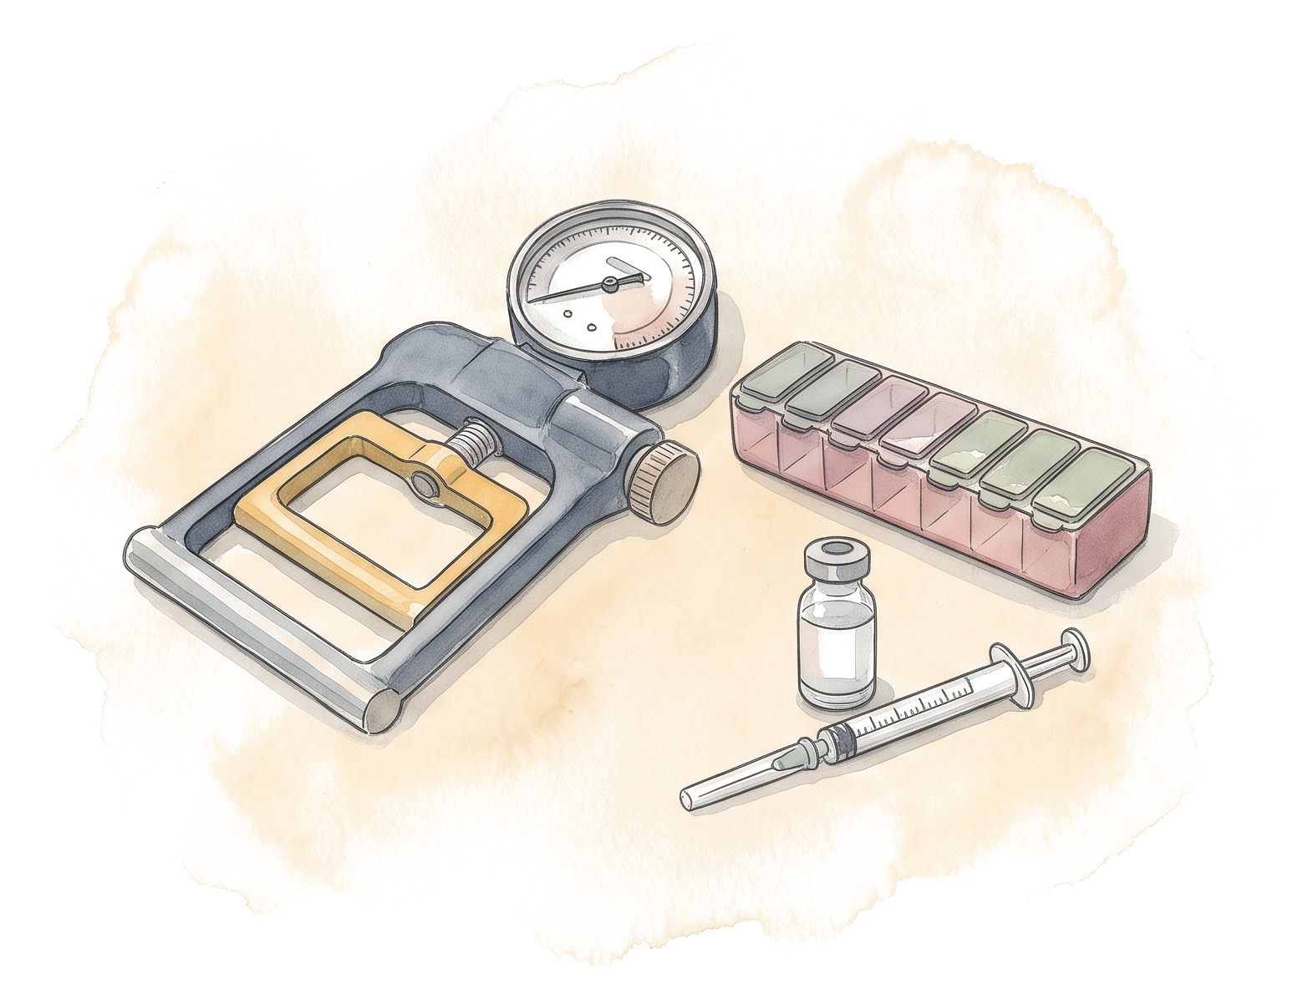
What can you do while the patient waits?
Treat alcohol use disorder, with medicines and counseling
Protein 1.2-1.5 g/kg ideal body weight a day, a late-evening snack
Exercise for frailty
Vaccines before transplant
No known HCC: surveillance every 6 months
Keep the MELD labs current
Dove L et al. Hepatology 2026;83(6):1609-45 [PMID: 41405234]. Lai JC et al. Hepatology 2021 [PMID: 34233031]
29/47
Notes:
This works best as shared care, with a clear owner for labs, HCC surveillance, nutrition and addiction treatment. Patients with known HCC are imaged on a different schedule by the transplant team. The patient who comes to transplant with muscle and without drinking does better.

Slide 32
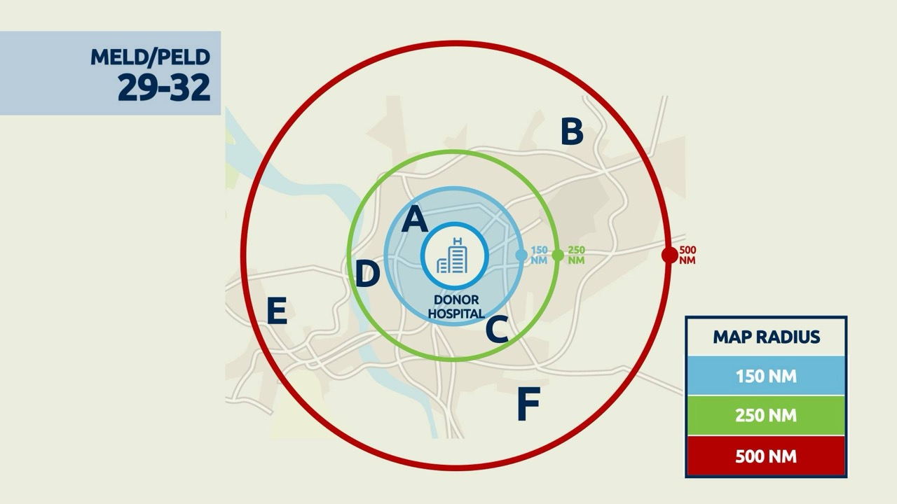
How does a liver get from a donor to a patient?
Circles of 150, 250 and 500 nautical miles around the donor hospital
Offers follow urgency first, then distance from the donor hospital
Exception points are set from the median MELD at transplant (MMaT) near the donor hospital
OPTN Policy 9, liver allocation (acuity circles since February 2020)
30/47
Notes:
Status 1 (mostly acute liver failure) gets the broadest priority, then MELD within each circle. Distance is measured from the donor hospital to the transplant hospital, not to the patient's home. The circles are always drawn around the donor hospital, and where a patient stands in them depends on the hospital where they're listed. Portland is roughly 85 nautical miles from Boston (check before saying it), so a liver donated here falls inside the first 150-mile circle for patients listed in Boston. Which brings us to where those livers come from.

Slide 33

Where the livers come from
31/47
Notes:
The reason transplant numbers are going up. Many DCD livers start in ICUs like yours; Maine's donor hospitals work with New England Donor Services, the same organization as Boston's (confirm with the hosts).

Slide 34
What kinds of donors are there?
Donor livers
Deceased donor
Living donor
Brain death (DBD)
Circulatory death (DCD)
Right lobe
Left lobe or left lateral segment
Either can go whole or be split
DCD: 43% of US deceased donor liver transplants in 2025
Living donor: 4.5% of US adult liver transplants in 2024
Giorgakis E et al. Transpl Int 2026;39:16689 [PMID: 42294094]. Kwong AJ et al. OPTN/SRTR 2024 Annual Data Report: Liver. Am J Transplant 2026;26(8S1):S214-S320 [PMID: 42276697]
32/47
Notes:
A split liver goes to two recipients, usually an adult and a child. The growth is almost all DCD.

Slide 35
How much has DCD grown?
Adult DCD recipients: median wait 112 vs 62 days, earlier vs later era
Giorgakis E, Ziogas IA, Moris D, et al. Transpl Int 2026;39:16689 [PMID: 42294094]
33/47
Notes:
DCD went from about 1 in 14 deceased donor livers to more than 4 in 10. The paper gives end points and era comparisons, not every year. The shorter wait is for adult DCD recipients only, and the paper doesn't show that perfusion caused it. The earlier era already had some perfusion in trials. Some of you will have read about the federal review of a Kentucky procurement organization in July 2025. DCD has strict rules: death is declared by a team that has nothing to do with the transplant, and there is a waiting period after the heart stops. That review led HRSA to ask for new national safeguards. The OPTN board approved them in 2026: anyone involved, the family included, can call a pause, and families get a standard set of information. They take effect November 18, 2026, the day of this talk.

Slide 36
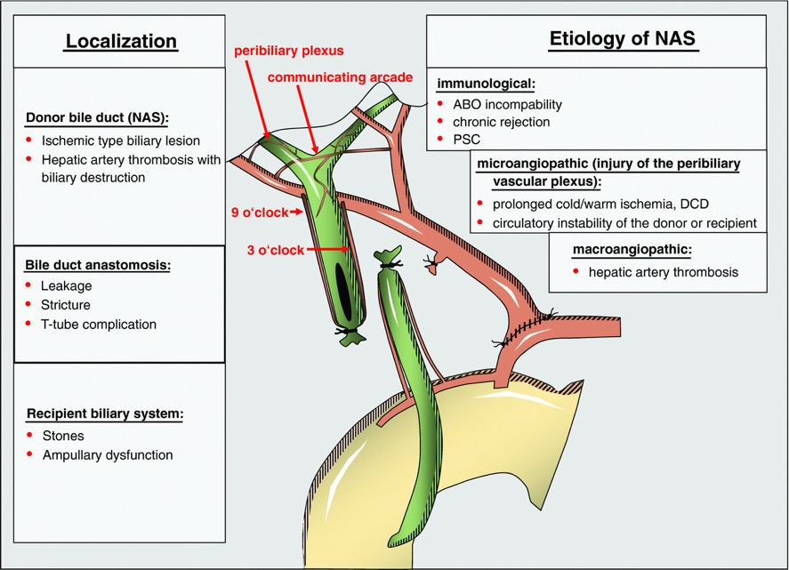
Why did DCD livers worry us?
After transplant, the donor bile ducts depend on the hepatic artery, through the peribiliary plexus
Warm ischemia during DCD injures that plexus and the duct lining
Weeks to months later: non-anastomotic strictures, sometimes needing retransplant
Seehofer D, Eurich D, Veltzke-Schlieker W, Neuhaus P. Am J Transplant 2013;13(2):253-65 [PMID: 23331505]
34/47
Notes:
This is the complication that kept DCD use low for years, and it's what the perfusion machines are meant to prevent.

Slide 37
When does the warm ischemia clock start?
Donor blood pressure and oxygen saturation
Withdrawal of life support
Circulation stops
Death declared, after a 5-min wait
Cold flush
Liver out, on ice
Definitions from Kalisvaart M, Croome KP, Hernandez-Alejandro R, et al. ILTS consensus working group. Transplantation 2021;105(6):1156-64 [PMID: 34048418]
35/47
Notes:
Walk through what happens in a DCD donation before showing the clocks. Ask: when do you think the liver starts to suffer?

Slide 38
When does the warm ischemia clock start?
Donor blood pressure and oxygen saturation
SpO2 <80% or MAP <60
Withdrawal of life support
Below threshold
Circulation stops
Death declared, after a 5-min wait
Cold flush
Liver out, on ice
Total donor warm ischemia
Hepatectomy
Functional warm ischemia: risk rises past 30 min
Agonal phase
Asystolic warm ischemia
With NRP, warm oxygenated blood reaches the liver again soon after death is declared
Definitions from Kalisvaart M, Croome KP, Hernandez-Alejandro R, et al. ILTS consensus working group. Transplantation 2021;105(6):1156-64 [PMID: 34048418]
35/47
Notes:
Start with what the ICU people here have seen: withdrawal in the ICU or the OR, the family there, and the wait. The clock that matters most is functional warm ischemia: from the moment saturation drops below 80% or mean pressure below 60, to the cold flush. That is the ILTS definition; ASTS used a mean pressure below 60, and the UK a saturation below 70 or systolic below 50. The ILTS doesn't set a hard cutoff: past 30 minutes graft loss goes up, and the call weighs the donor, the graft, the recipient and how the liver will be preserved. ASTS suggested 20 to 30 minutes at most, and the UK doesn't use the liver past 30. If the donor doesn't die within the program's window after withdrawal, the liver isn't used. Withdrawal in the OR shortens the functional time, which is what ILTS recommends where local rules allow. The no-touch wait after the heart stops ranges from 2 to 20 minutes around the world and is usually 5 in the US. Nobody touches the donor during it, and death is declared by a team that has nothing to do with the transplant. Hepatectomy time, from the flush until the liver is on ice, matters too. After that come cold storage and the recipient's own warm ischemia during the implant. NRP restarts warm oxygenated blood flow to the abdominal organs after death is declared, and in observational studies NRP livers have had fewer bile duct problems.

Slide 39
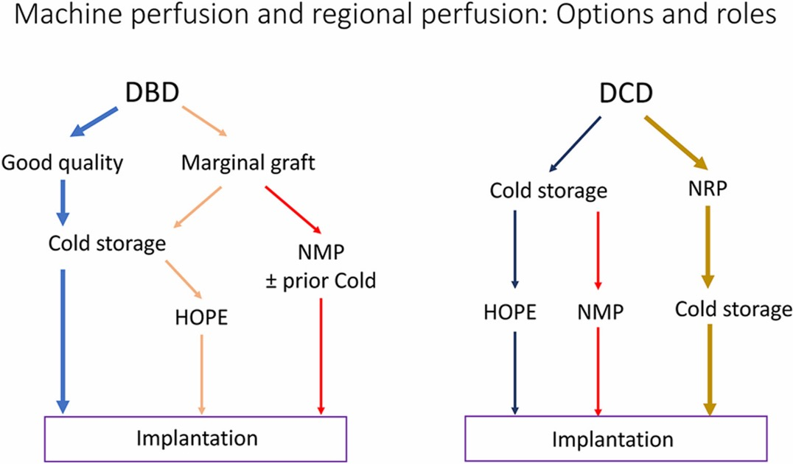
What does a perfusion machine do?
HOPE keeps the liver cold but gives it oxygen, usually at the transplant center just before the implant
NMP keeps it warm on blood; the liver makes bile and can be tested before anyone commits to it
NRP restarts oxygenated blood flow to the donor's abdominal organs after death is declared
J Clin Exp Hepatol 2024;14(2):101309 [PMID: 38274508]
36/47
Notes:
Cold storage just slows metabolism down. The machines either replace oxygen cold or keep the liver working at body temperature, and the warm ones let us see whether the liver works before we commit to it. In the diagram, the left side is brain-death donors and the right side DCD.

Slide 40
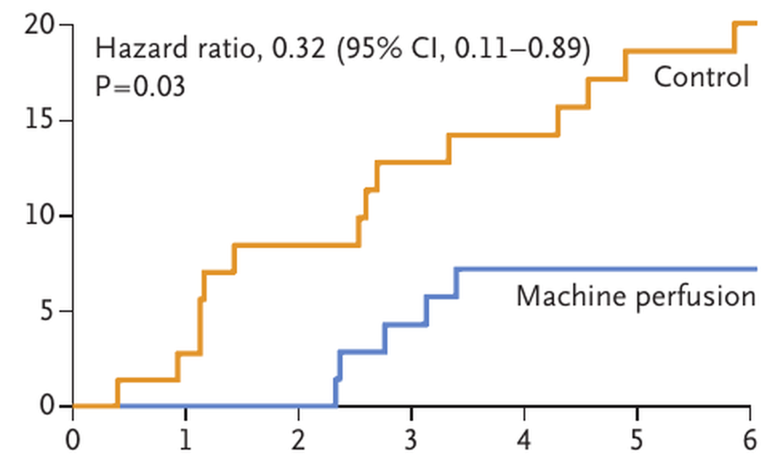
What did the trials show?
Trial | Machine | Main result
Nasralla, Nature 2018 | NMP | Peak AST and discard 50% lower
PROTECT, JAMA Surg 2022 | NMP (OCS) | Early allograft dysfunction 18% vs 31% Ischemic biliary 2.6% vs 9.9%
DHOPE-DCD, NEJM 2021 | DHOPE | Symptomatic non-anastomotic strictures 6% vs 18% at 6 months, RR 0.36
DHOPE-DCD: symptomatic non-anastomotic strictures (%), by month
The 2025 AASLD/AST and 2024 EASL guidelines both recommend machine perfusion for DCD and extended-criteria livers.
Nasralla D et al. Nature 2018 [PMID: 29670285]. Markmann JF et al. JAMA Surg 2022 [PMID: 34985503]. van Rijn R et al. N Engl J Med 2021 [PMID: 33626248]. Te HS et al. 2026, statements 6-10 [PMID: 40844852]. EASL 2024, p.1062
37/47
Notes:
Early allograft dysfunction is the Olthoff definition: bilirubin 10 or more or INR 1.6 or more on day 7, or AST or ALT over 2000 in the first week. Non-anastomotic strictures are the ischemic cholangiopathy from two slides back. Nasralla randomized 220 transplants and measured graft injury as peak AST. PROTECT's ischemic biliary complications are at 12 months, and it also used 51% of the DCD livers it assessed vs 26% in the control arm. Nasralla's machine kept livers 54% longer. The three trials studied different livers and end points; none compared one machine with another. They are the basis for the guideline recommendations on the line below.

Slide 41
Does NRP help the liver, and is it allowed?
17 US centers, 2017-2023 | NRP (106) vs super-rapid (136)
Ischemic cholangiopathy
Early allograft dysfunction
Hospital stay, median
Primary nonfunction
Patient and graft survival
Brubaker AL et al. JAMA Surg 2024;159(6):677-85 [PMID: 38568597]. OPTN/HRSA NRP safety notice, November 21, 2025. HRSA, NRP policy issue page (accessed 10/2026)
38/47
Notes:
Ask the room: would you expect better or worse livers, and do you think it is legal everywhere?

Slide 42
Does NRP help the liver, and is it allowed?
17 US centers, 2017-2023 | NRP (106) vs super-rapid (136)
Ischemic cholangiopathy | Lower with NRP
Early allograft dysfunction | Lower with NRP
Hospital stay, median | 7 vs 10 days
Primary nonfunction | 0 vs 2 grafts
Patient and graft survival | Similar
No federal or state law names NRP; the argument is over the dead donor rule
November 2025: OPTN/HRSA safety notice on cutting and venting the vessels to the brain
An OPTN workgroup has been drafting national NRP policy since October 2025
Brubaker AL et al. JAMA Surg 2024;159(6):677-85 [PMID: 38568597]. OPTN/HRSA NRP safety notice, November 21, 2025. HRSA, NRP policy issue page (accessed 10/2026)
38/47
Notes:
NRP comes in two forms: abdominal only, or thoraco-abdominal, where the heart beats again in the body (diagram in the appendix). The vessels to the brain are clamped and cut first either way. This is a retrospective US multicenter study, not a trial; the Spanish and UK registry data point the same way, with fewer bile duct problems after NRP. On the rules: the US has no statute that permits or bans NRP. Critics, including the American College of Physicians, argue that restarting circulation after death is declared may not fit the Uniform Determination of Death Act, which almost every state has adopted. HRSA has been asking the OPTN for NRP data since 2024, the November 2025 safety notice made the vessel steps explicit, and the OPTN workgroup's draft policy still has to go to the board. This is likely to change, so check before the talk.

Slide 43
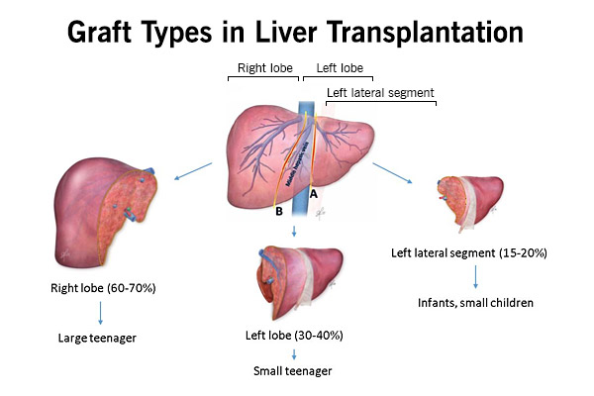
What about living donors?
4.5% of US adult liver transplants in 2024
Aim for a graft-to-recipient weight ratio of 0.8% or more
Caution above MELD 30
Older recipient age alone doesn't exclude
Dove L et al. Hepatology 2026;83(6):1609-45 [PMID: 41405234], statements 50-53. Kwong AJ et al. OPTN/SRTR 2024 Annual Data Report: Liver. Am J Transplant 2026;26(8S1):S214-S320 [PMID: 42276697]
39/47
Notes:
Adult recipients mostly get a right lobe. The graft size ratio is a planning target, not a hard cutoff. The main message: bring up living donation early, at the first visit.

Slide 44
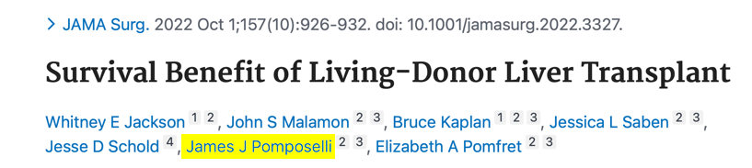
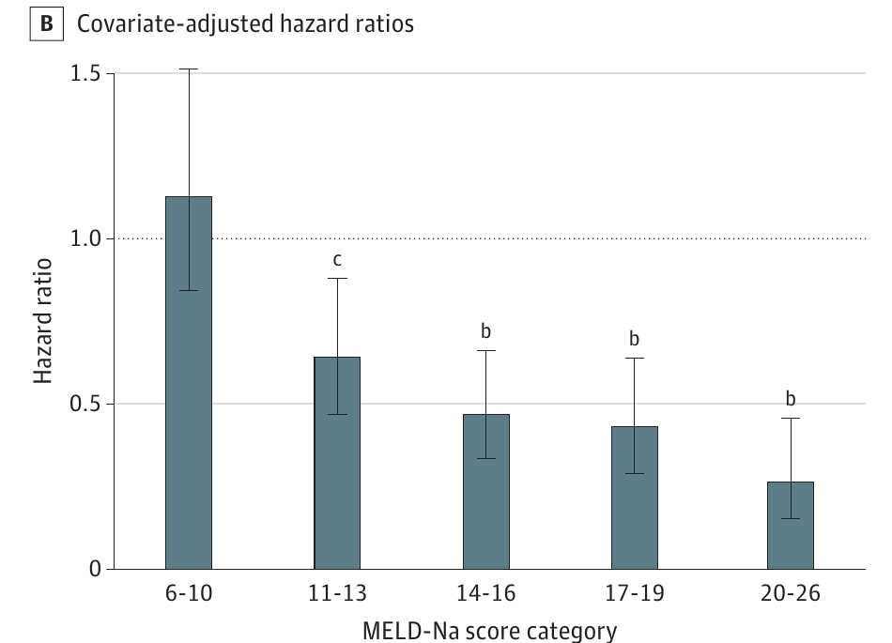
Is there benefit below MELD 15 with a living donor?
Adjusted, compared with staying on the list:
MELD-Na 11-13: aHR 0.64 (0.47-0.88)
MELD-Na 14-16: aHR 0.47 (0.34-0.66)
Modeled gain of 13-17 life-years
Jackson WE, Malamon JS, Kaplan B, Saben JL, Schold JD, Pomposelli JJ, Pomfret EA. JAMA Surg 2022;157(10):926-932 [PMID: 35921119]
40/47
Notes:
With a living donor the benefit starts well below 15, so living donation is worth raising before a patient reaches the old deceased donor threshold. Figure 1B, adjusted for age at listing, sex and primary diagnosis. James Pomposelli, one of the authors, is now our colleague at Tufts.

Slide 45
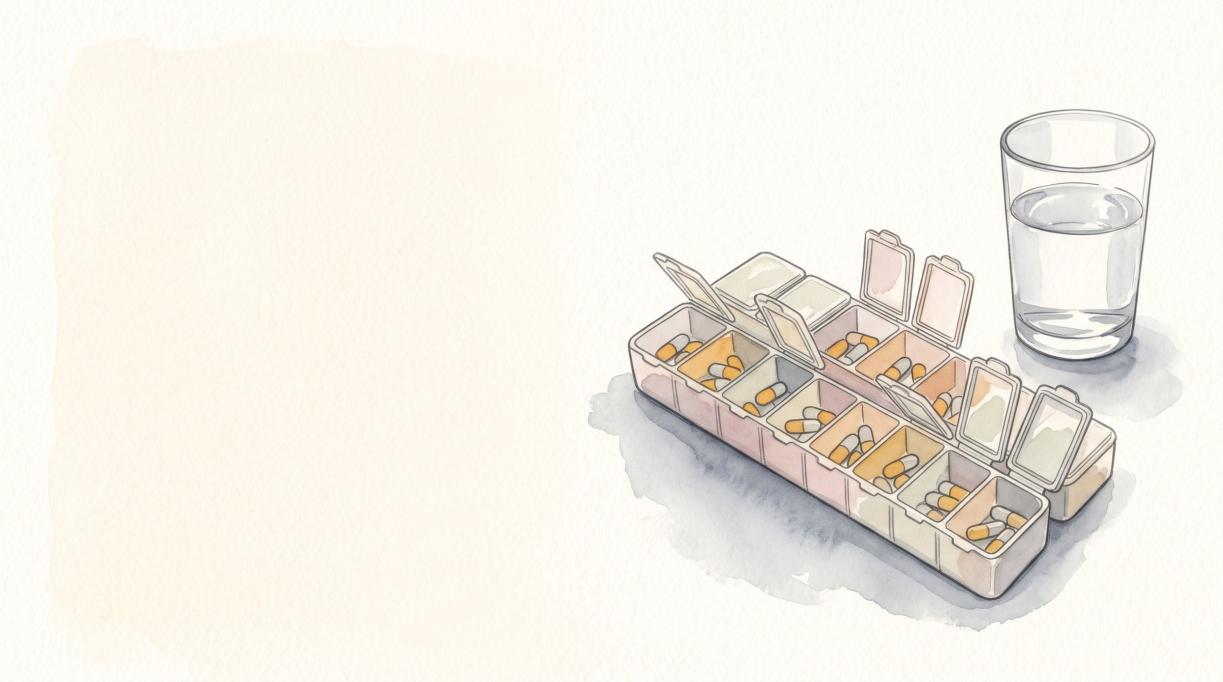
Your patient had a transplant
41/47
Notes:
For everyone who admits or follows a transplant patient. Show of hands: who has had a transplant patient on their service in the last month?

Slide 46
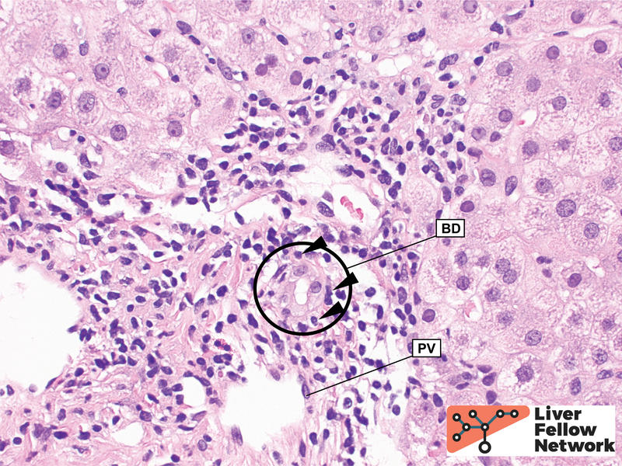
Abnormal liver tests after transplant: what next?
New or rising liver tests: call transplant hepatology the same day
Look at the timing, the pattern, new drugs and old labs
Doppler ultrasound and a correctly timed tacrolimus trough
Think vascular, biliary, infection, drugs and rejection
The transplant team decides on a biopsy
Acute cellular rejection
Te HS et al. AASLD/AST graft-related complications guideline. Liver Transpl 2026;32(3):444-90 [PMID: 40844852], statement 34. Histology: Liver Fellow Network
42/47
Notes:
The guideline has no numbered algorithm for abnormal tests; statement 34 covers the biopsy, and the rest is our practice. Rejection is one cause among several, so please call us before giving steroids.

Slide 47
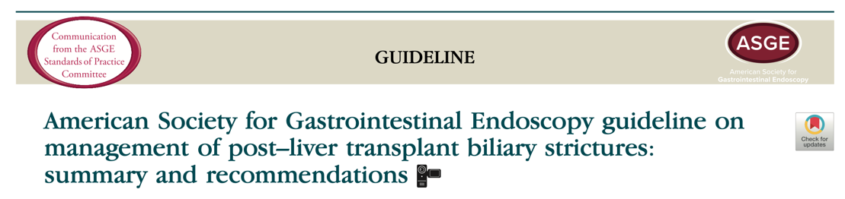
MRCP or ERCP for a suspected stricture?
Situation | Next step
Suspected stricture | MRCP first (strong)
High suspicion, or intervention likely | ERCP directly (weak)
Normal MRCP, picture still fits | ERCP (weak)
Progressive ischemic cholangiopathy | Consider retransplant
Te HS et al. AASLD/AST graft-related complications guideline. Liver Transpl 2026;32(3):444-90 [PMID: 40844852], statements 15, 16, 24. Kohli DR et al. ASGE guideline. Gastrointest Endosc 2023;97(4):607-14 [PMID: 36797162]
43/47
Notes:
The ASGE guideline lands in the same place: MRCP when the diagnosis is unclear, ERCP when you expect to treat.

Slide 48
Which drugs change tacrolimus levels?
Raise levels (toxicity) | Lower levels (rejection)
Fluconazole, voriconazole, posaconazole | Rifampin
Clarithromycin, erythromycin | Phenytoin, carbamazepine
Diltiazem, verapamil | Phenobarbital
Nirmatrelvir/ritonavir (Paxlovid) | St John's wort
Ritonavir- or cobicistat-boosted HIV drugs
Grapefruit, cannabidiol (CBD)
Starting or stopping a drug, or the patient can't take pills: call transplant pharmacy or hepatology for a plan.
Tacrolimus (Prograf) prescribing information. Sharma P et al. AASLD/AST non-graft complications guideline. Liver Transpl 2026;32(8):1157-93 [PMID: 41405235]
44/47
Notes:
This is the slide to photograph. Any new drug in a transplant patient, check it against tacrolimus, and stopping a drug matters as much as starting one. Nirmatrelvir/ritonavir is a common one now: it can push levels very high within days. No herbal supplements without asking the transplant team, and no grapefruit. Maine Med has its own kidney transplant program, so: "Your kidney transplant colleagues know this list better than anyone." Optional line: "The usual story: Paxlovid from urgent care, and a tacrolimus level of 40 three days later."

Slide 49
What does the primary care doctor need to do?
 | What the 2025 AASLD/AST guideline says
Vaccines | ACIP schedule for immunocompromised adults; no live vaccines
Skin | Skin exam every year, plus age-appropriate cancer screening
Alcohol | None, whatever the original liver disease
Type 2 diabetes | GLP-1 RA or SGLT2i first if high CV, heart failure or CKD risk
Lipids | Hydrophilic statin first
Elective surgery | At least 3 months after transplant, with stable graft function
Sharma P et al. AASLD/AST non-graft complications guideline. Liver Transpl 2026;32(8):1157-93 [PMID: 41405235], statements 9, 19-20, 44-45, 59, 62, 83
45/47
Notes:
After the first year, the long-term problems are cardiovascular disease, kidney disease, cancer and the side effects of immunosuppression, more than the graft. Skin cancer is the most common cancer after transplant. Also in the guideline: BP, weight, glucose and lipids every year; metformin first for diabetes otherwise; amlodipine or felodipine for blood pressure, or an ACE inhibitor or ARB with CVD or CKD; GLP-1 RA for obesity; nephrology at CKD stage 4, and for CKD the transplant team lowers tacrolimus, so please don't stop it. Pregnancy waits a year with 6 months of stable graft function, and mycophenolate is stopped 6 weeks before conception in women and 90 days in men. The guideline also covers bone health and a yearly check for depression and alcohol use. The transplant team manages immunosuppression around surgery.

Slide 50
Take-home points
Refer after any decompensating event. Without one, MELD 15 is still reasonable, and a low MELD alone shouldn't stop a referral
Acute liver failure or ACLF: call the same day
Recent drinking calls for assessment and treatment, not an automatic no
Colorectal metastases and selected cholangiocarcinoma are worth a call
After transplant, abnormal liver tests mean a call to transplant hepatology the same day
Check every new drug against tacrolimus
AASLD/AST guidelines: candidate evaluation [PMID: 41405234], graft complications [PMID: 40844852], non-graft complications [PMID: 41405235]
46/47

Slide 51
Questions?
47/47
Notes:
Likely questions. MELD at transplant in Boston: have the current median for our area ready as a rough number. How do your patients do: point to the SRTR program-specific report and the national 93.5% at one year; no Tufts survival numbers. Relapse after early transplant for alcohol-associated hepatitis: describe the alcohol program and monitoring after transplant. MaineCare and out-of-state transplant, and travel or lodging help for families. Listing at more than one center. Whether the patient has to stay within a few hours of Boston once listed. Whether NRP is done in Maine hospitals: ask the hosts or New England Donor Services beforehand. Pig livers: one sentence on the 2026 J Hepatol case.

Slide 52
Who can get a transplant for intrahepatic CCA?
 | With cirrhosis | Without cirrhosis
Tumor | Solitary, unresectable, <3 cm | Unresectable
Biopsy | Required | Required
Before listing | 6 months stable after treatment | ≥6 months stable on systemic therapy
Outside the liver | No disease | No disease
Setting | Exception points by review (MMaT-3) | Research protocols only
Kodali S, Kulik L, D'Alessio A, et al. ILTS-ILCA consensus. Liver Transpl 2025;31(6):815-31 [PMID: 40014003]. Dove L et al. Hepatology 2026;83(6):1609-45 [PMID: 41405234], statement 11. OPTN transplant oncology review guidance
A1
Notes:
Cut if running long. Small tumors in cirrhosis, often found on the explant, did well, which is where this started. The guideline says under 3 cm; the OPTN review guidance says 3 cm or less. The treatment before listing can be local or systemic. Once listed, imaging every 3 months has to show no growth and no new tumors.

Slide 53
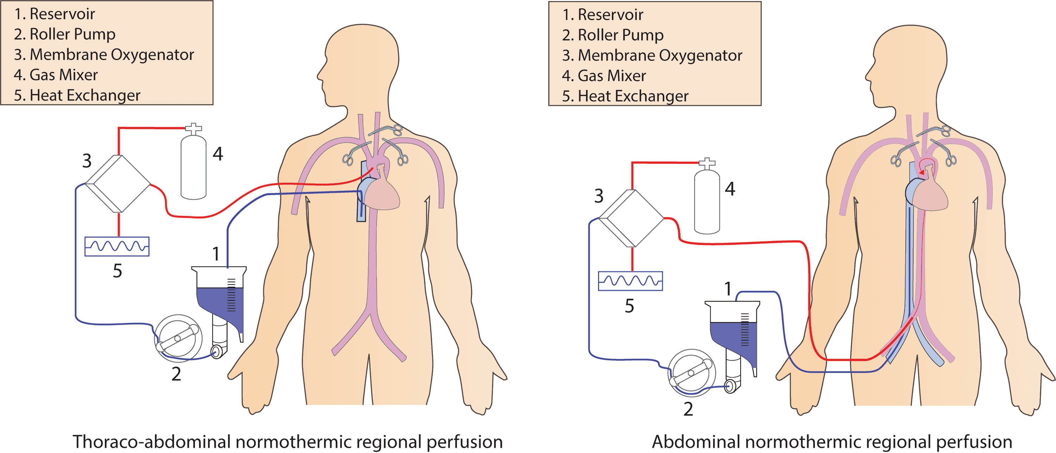
How do TA-NRP and A-NRP differ?
TA-NRP: the chest is opened and the arteries to the head are clamped, cut and vented. The heart beats again, so heart, lungs and abdominal organs can all be used.
A-NRP: the aorta is blocked above the celiac and cut above the block. Only the abdominal organs get blood; the heart doesn't restart.
Figure: Alamouti-Fard E, Garg P, Wadiwala IJ, et al. Cureus 2022;14(6):e26437, CC BY 4.0. Vessel steps: OPTN/HRSA NRP safety notice, November 21, 2025
A2
Notes:
Both start only after death is declared and the no-touch wait is over. The circuit is basically ECMO: reservoir, pump, oxygenator and heater. The liver gets warm oxygenated blood again, usually for an hour or two, and the team follows lactate and liver tests to decide whether to use it. TA-NRP is one of the two ways DCD hearts are recovered in the US; the other takes the heart straight onto a machine. Cutting and venting the vessels is what keeps blood from reaching the brain. The November 2025 OPTN/HRSA safety notice spelled those steps out for both setups after concerns about unintended brain reperfusion.

Slide 54
Appendix: sources (1)
AASLD/AST candidate evaluation guideline. Hepatology 2026 [PMID: 41405234]
AASLD/AST graft-related complications guideline. Liver Transpl 2026 [PMID: 40844852]
AASLD/AST non-graft complications guideline. Liver Transpl 2026 [PMID: 41405235]
EASL CPG on liver transplantation. J Hepatol 2024 [PMID: 39487043]
ACG alcohol-associated liver disease guideline. Am J Gastroenterol 2024 [PMID: 38174913]
ACG acute liver failure guideline. Am J Gastroenterol 2023 [PMID: 37377263]
AASLD ACLF and critically ill cirrhosis guidance. Hepatology 2024 [PMID: 37939273]
Lai JC et al. Frailty and sarcopenia guidance. Hepatology 2021 [PMID: 34233031]
Kodali S et al. ILTS-ILCA iCCA consensus. Liver Transpl 2025 [PMID: 40014003]
OPTN Policy 9 (effective 10/1/2026) and transplant oncology review guidance
OPTN/SRTR Annual Data Reports, Liver, 2020-2024 [PMIDs: 35266621, 37132348, 38431359, 39947804, 42276697]
A3

Slide 55
Appendix: sources (2)
Zarrinpar A, Busuttil RW. Nat Rev Gastroenterol Hepatol 2013 [PMID: 23752825]
Starzl TE et al. Homotransplantation of the liver in humans. Surg Gynecol Obstet 1963 [PMID: 14100514]
Malinchoc M et al. Hepatology 2000 [PMID: 10733541]; Kamath PS et al. Hepatology 2001 [PMID: 11172350]
Kim WR et al. MELD 3.0. Gastroenterology 2021 [PMID: 34481845]
Tanaka T et al. MELD 3.0 and sex disparities. Hepatology 2026 [PMID: 41100798]
Di Napoli M et al. Front Transplant 2026 [PMID: 42266471]
Merion RM et al. Survival benefit of LT. Am J Transplant 2005 [PMID: 15643990]
Malamon JS et al. Survival benefit of DDLT. Int J Surg 2023 [PMID: 37226874]
Perkins JD et al. LT at MELD ≤14, decision analysis. Liver Transpl 2009 [PMID: 19177441]
Jackson WE et al. Living donor LT benefit. JAMA Surg 2022 [PMID: 35921119]
Mathurin P et al. Early LT for alcoholic hepatitis. N Engl J Med 2011 [PMID: 22070476]
Lee BP et al. ACCELERATE-AH. Gastroenterology 2018 [PMID: 29655837]
Dukewich M et al. Early LT for AH, 5-year outcomes. Am J Gastroenterol 2025 [PMID: 38994850]
A4

Slide 56
Appendix: sources (3)
Louvet A et al. QuickTrans. Lancet Gastroenterol Hepatol 2022 [PMID: 35202597]
Gustot T et al. CHANCE. J Hepatol 2026 [PMID: 42822699]
Adam R et al. TransMet. Lancet 2024 [PMID: 39306468]
Chávez-Villa M et al. LT for colorectal metastases in the US. Liver Transpl 2026 [PMID: 41086433]
Giorgakis E et al. DCD and machine perfusion in the US. Transpl Int 2026 [PMID: 42294094]
Seehofer D et al. Non-anastomotic strictures. Am J Transplant 2013 [PMID: 23331505]
Kalisvaart M et al. ILTS donor warm ischemia time. Transplantation 2021 [PMID: 34048418]
Machine and regional perfusion options. J Clin Exp Hepatol 2024 [PMID: 38274508]
Nasralla D et al. Nature 2018 [PMID: 29670285]; Markmann JF et al. PROTECT. JAMA Surg 2022 [PMID: 34985503]
van Rijn R et al. DHOPE-DCD. N Engl J Med 2021 [PMID: 33626248]
Kohli DR et al. ASGE post-LT biliary strictures. Gastrointest Endosc 2023 [PMID: 36797162]
Tacrolimus (Prograf) prescribing information
The New York Times, March 5, 2017 (Starzl obituary)
A5

Slide 57
Appendix: sources (4)
Brubaker AL et al. NRP vs super-rapid recovery. JAMA Surg 2024 [PMID: 38568597]
Alamouti-Fard E et al. NRP in DCD heart transplantation. Cureus 2022;14(6):e26437
OPTN/HRSA NRP safety notice, November 21, 2025, and HRSA NRP policy issue page
A6

